Slide 1
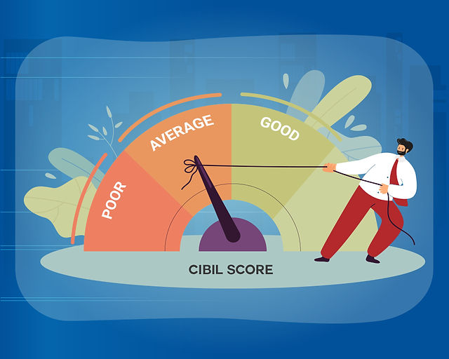
Credit Score classification
Random forest

Slide 2
Problem statement
Credit card and bank companies calculates the credit score by considering multiple factors, This helps bank and credit
Card companies to issue loan to the specific Person immediately. In this project we are creating a machine learning model
To determine which type of credit score person had through classification.
There are three credit scores that banks and credit card companies use to label their customers:
Good
Standard
Poor

Slide 3
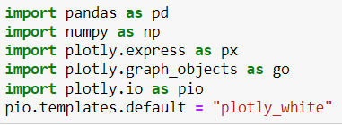



Adding important libraries and Reading files
Importing libraries for data wrangling and plotting data.
Importing csv file and round off all dataset.
Looking at the information about the columns in the dataset
Returns the number of missing values in the dataset.
Looking at number of values of credit scores.

Slide 4
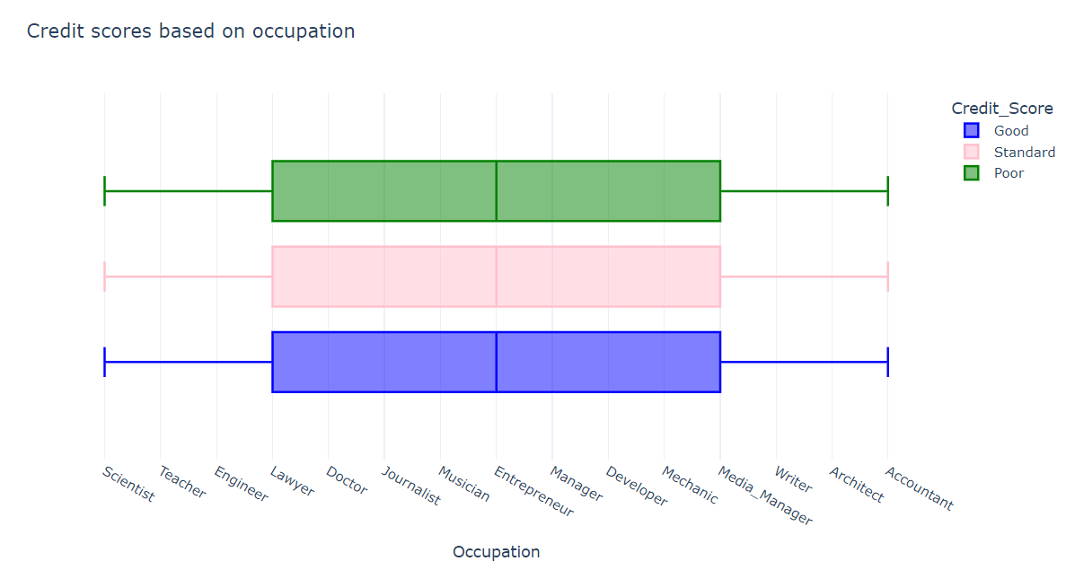
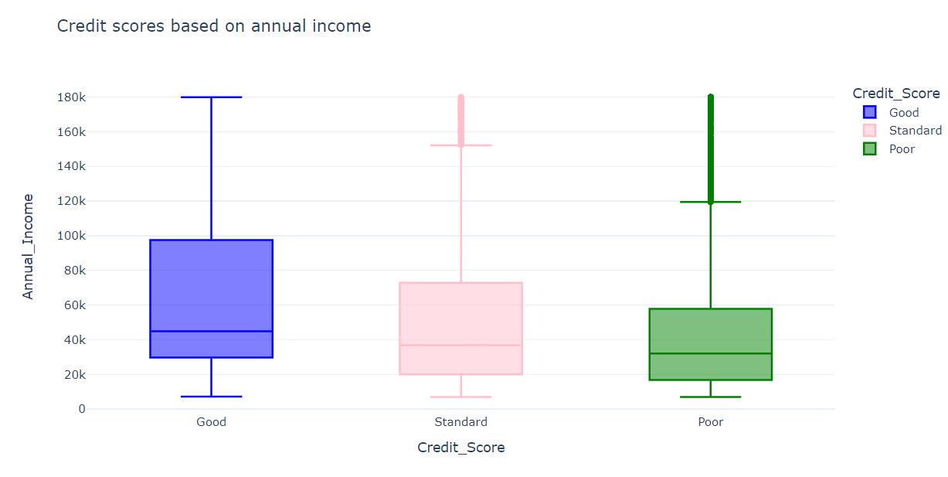
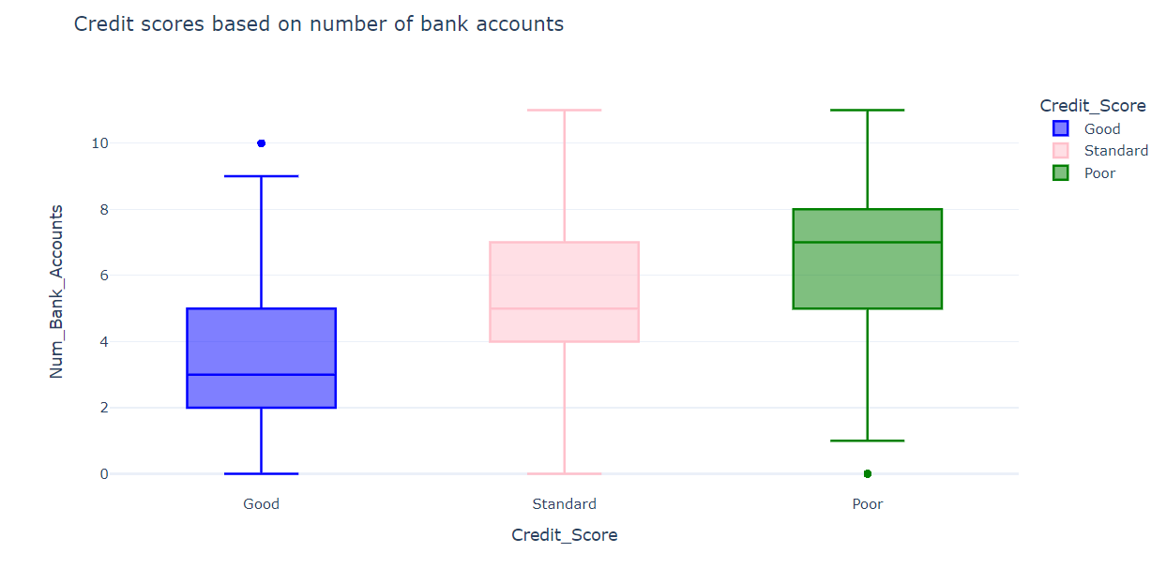
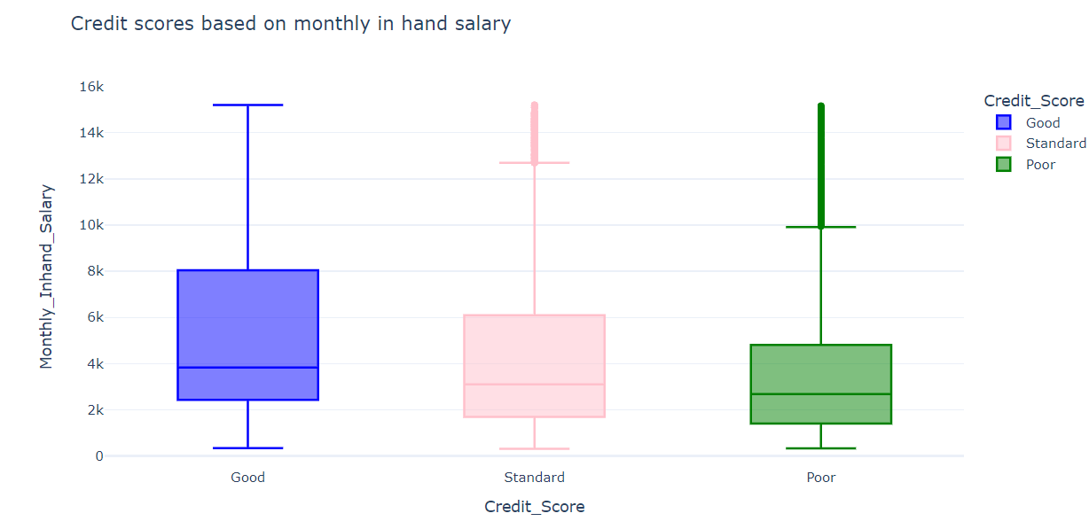

Slide 5
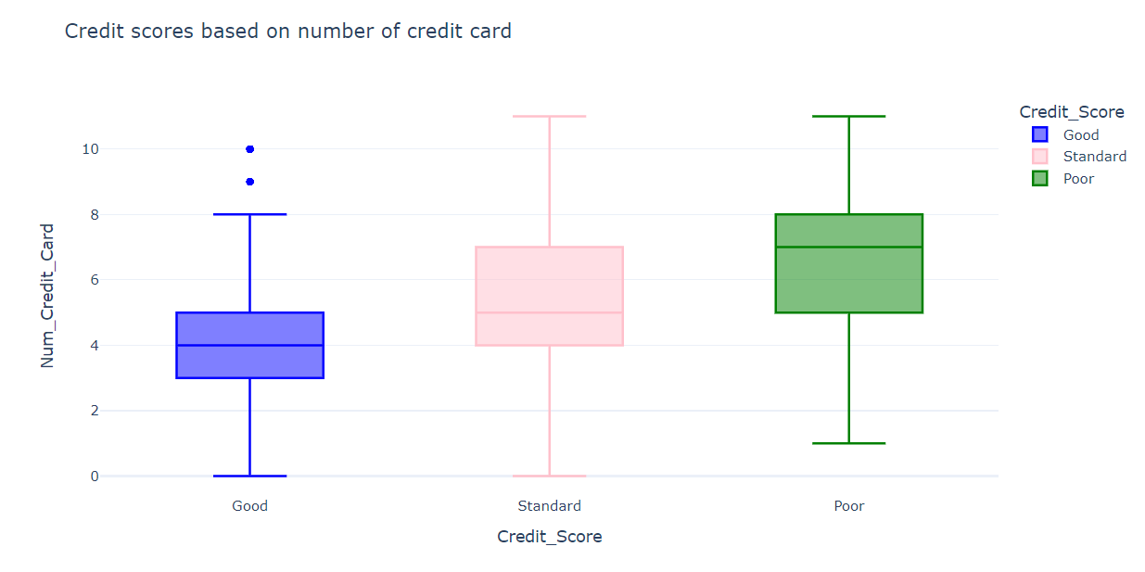
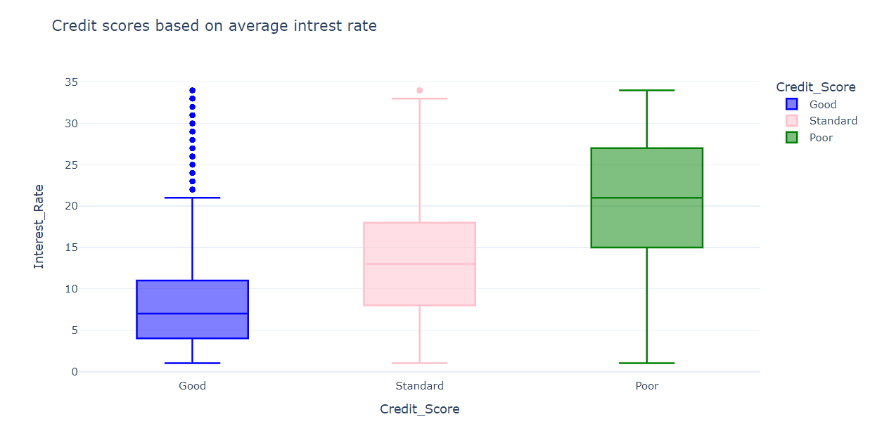
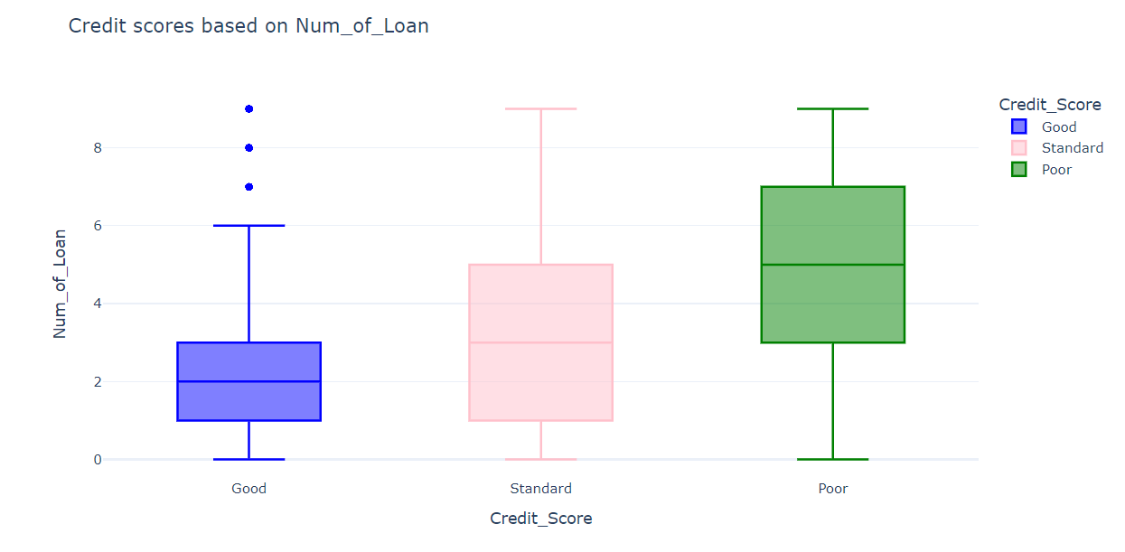
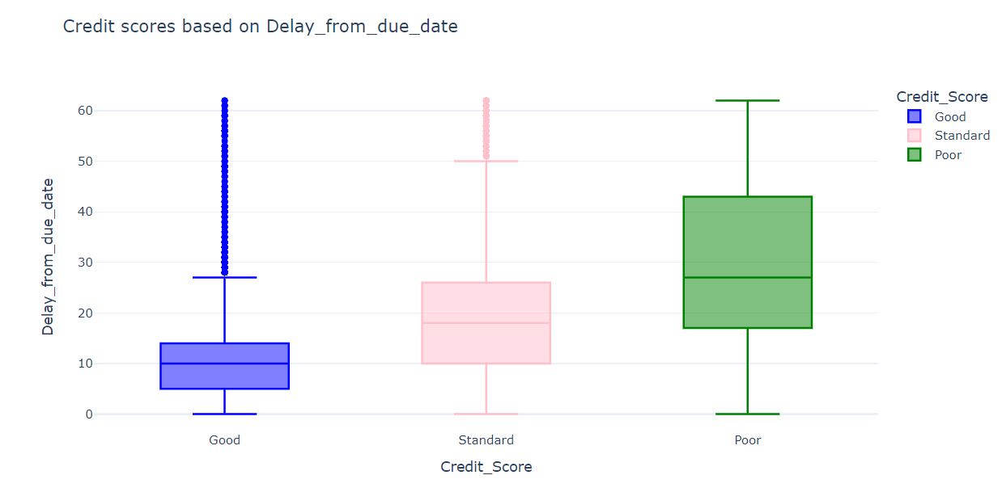

Slide 6
Data exploration
The more you earn annually and in hand salary, the better your credit score is.
Maintaining more than five accounts and credit card is not good for having a good credit score. A person should have 2 – 3 bank accounts only.
the average interest rate is 4 – 11%, the credit score is good. Having an average interest rate of more than 15% is bad for your credit scores.
To have a good credit score, you should not take more than 1 – 3 loans at a time.
Delaying your payments for more than 17 days from the due date will impact your credit scores negatively.

Slide 7
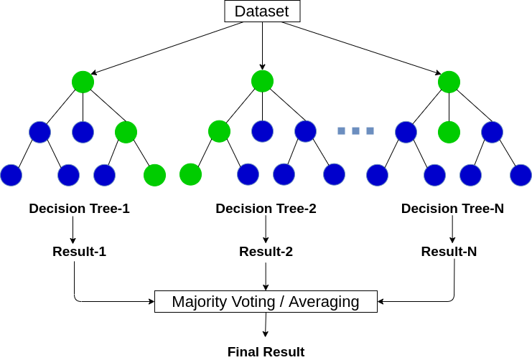
Random Forest classifier
Random Forest is a popular machine learning algorithm that belongs to the supervised learning technique. It can be used
for both Classification and Regression problems in ML. It is based on the concept of ensemble learning, which is a
process of combining multiple classifiers to solve a complex problem and to improve the performance of the model.
Random Forest is a classifier that contains a number of decision trees on various subsets of the given dataset and takes the average to improve the predictive accuracy of that dataset.
It takes less training time as compared to other algorithms.
It predicts output with high accuracy, even for the large dataset it runs efficiently.
It can also maintain accuracy when a large proportion of data is missing.

Slide 8
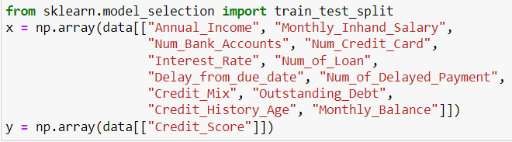
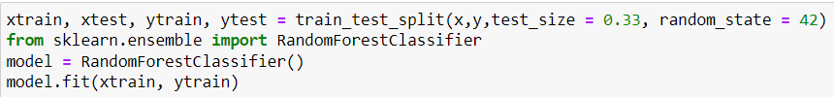
Splitting dataset and training model
Splitting data into dependent and independent columns
Splitting data into test and train dataset.
Creating model.

Slide 9
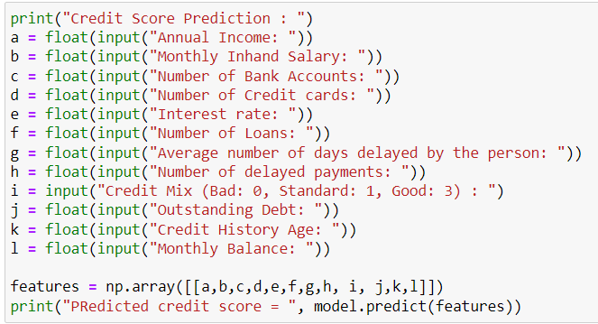
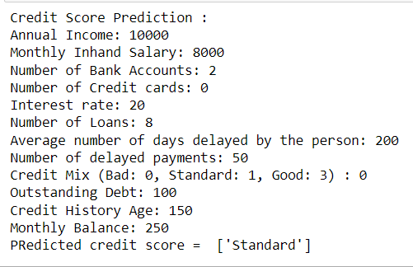
Testing prediction
Predicting model by giving inputs.

Slide 10
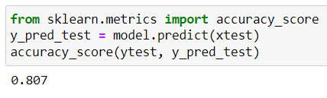
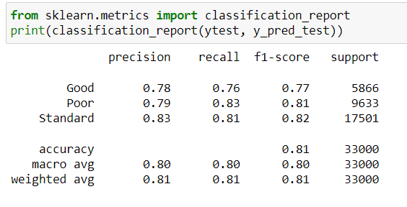
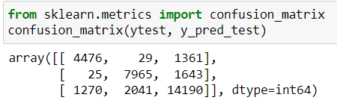
Evaluating the prediction
Percentage of labels that our model successfully predicted
Confusion matrix represents an actual class, while each column represents a predicted class

Slide 11
Thank you

